Slide 1
Virtual TCAM for Data Center Switches
Author: Qasim Maqbool, Junaid Zulfiqar, Sohaib Ayub, Aamir Shafi
Publisher/Conference: 2015 IEEE Conference on Network Function Virtualization and Software Defined Network
Presenter: Cheng-Feng Ke
Date: 2017/06/20
Department of Computer Science and Information Engineering
National Cheng Kung University, Taiwan R.O.C.
Notes:
1

Slide 2
INTRODUCTION
In this paper, we introduce the concept of T-Flex; a Flexible TCAM for data center switches. We leverage the presence of on-board CPUs in ToR switches to develop a virtual memory for storing TCAM rules.
Just like the OS uses on-disk virtual memory to extend the amount of memory available to applications.

Slide 3
ARCHITECTURE
ToR Switch
(Linux OS)
ASIC
(Application-Specific Integrated Circuit)
Open vSwitch
(Application)
TCAM
Virtual TCAM Table
(Hypercuts)
Default rule
(Lowest priority)
Forward packet
Leaf Node
(Hypercut buckets)
(64 rules)
Insert node

Slide 4
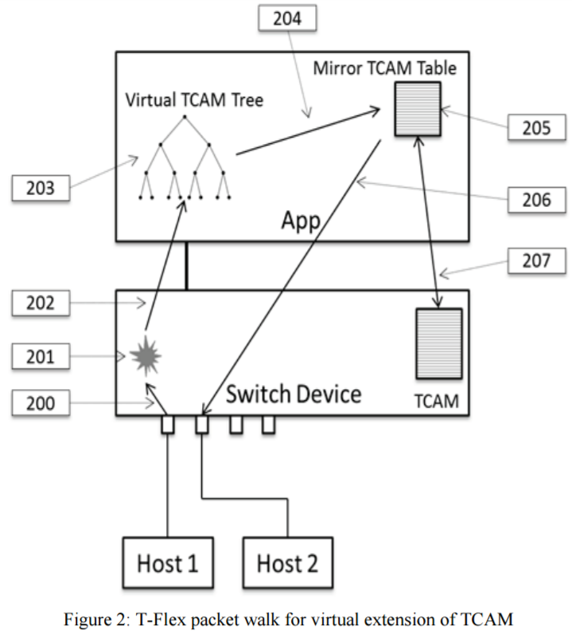
ARCHITECTURE
Figure 2 – 200:
The packet comes in from Host 1.

Slide 5
ARCHITECTURE
Figure 2 – 201:
The incoming packet has no forwarding matching rule in the switch TCAM and hence a TCAM Miss takes place.

Slide 6
ARCHITECTURE
Figure 2 – 202:
All packets with no matching rules in the switch TCAM will hit default rule and get redirected to TFlex.

Slide 7
ARCHITECTURE
Figure 2 – 203:
It may happen that there is no matching rule in the VTT for this incoming packet. In this case, either the default rule is applied or the packet is sent to OpenFlow controller.

Slide 8
ARCHITECTURE
Figure 2 – 203:
Second possibility is that a leaf node containing matching rule(s) is found.

Slide 9
ARCHITECTURE
Figure 2 – 204:
Takes place and the leaf node is scheduled to be inserted into the switch TCAM.

Slide 10
ARCHITECTURE
Figure 2 – 205:
The Mirror TCAM Table (MTT) is a linked list that mirrors contents of the switch TCAM.

Slide 11
ARCHITECTURE
Figure 2 – 206:
T-Flex application soft switches the incoming packet to its destination front panel port.

Slide 12
ARCHITECTURE
Figure 2 – 207: T-Flex starts a synchronization thread, which is responsible for inserting all scheduled leaf nodes. While this thread inserts new nodes, it also makes room in the switch TCAM by running an eviction algorithm that inspects corresponding bytes count of each rule and makes the eviction decision. In summary, the sync thread decides to evict any node with least bytes counts since this has been the least used set of rules in the switch TCAM.

Slide 13
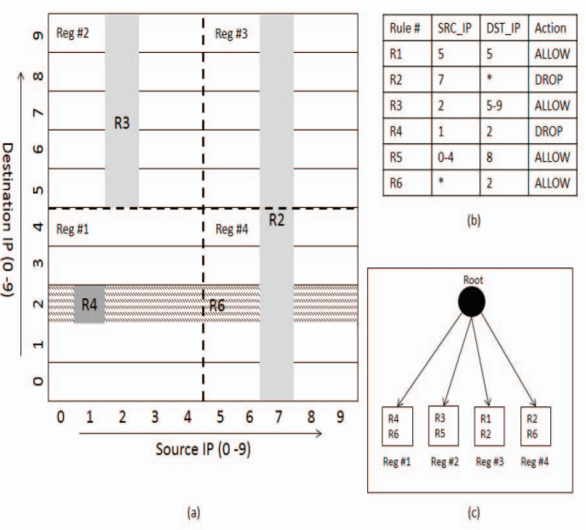
Partition-with-Splitting
TCAM
Reg #1 (R4) (R6)
Reg #2 (R3) (R5)
Reg #4 (R2) (R6)

Slide 14

Partition-with-Splitting
TCAM
Reg #1 (R4) (R6)
Reg #2 (R3) (R5)
Reg #4 (R2) (R6)
DROP
(src=1, dst=2)

Slide 15
Partition-with-Splitting
TCAM
Reg #4 (R2) (R6)
Reg #2 (R3) (R5)
Reg #1 (R4) (R6)

Slide 16
Partition-with-Splitting
TCAM
Reg #4 (R2) (R6)
Reg #2 (R3) (R5)
Reg #1 (R4) (R6)
ALLOW
(src=1, dst=2)

Slide 17
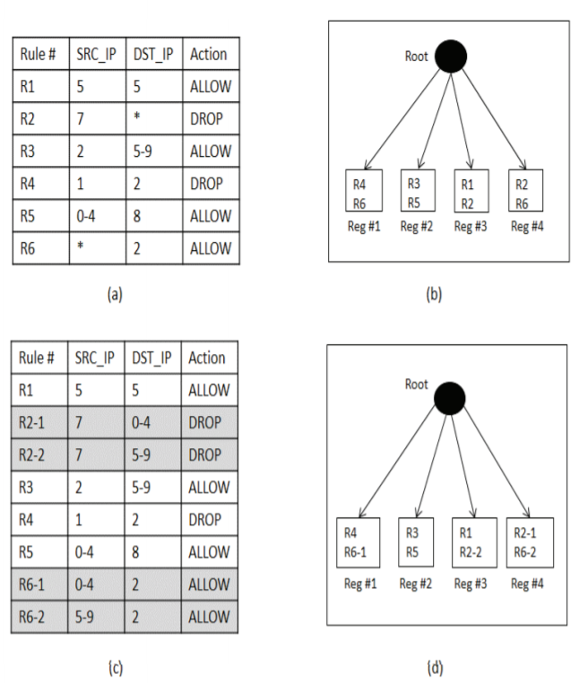
Partition-with-Splitting
TCAM
Reg #4 (R2-1) (R6-2)
Reg #2 (R3) (R5)
Reg #1 (R4) (R6-1)
DROP
(src=1, dst=2)

Slide 18
EVALUATION
To evaluate the performance of T-Flex, we deployed it in an actual data center environment. (p5)
A number of different traffic patterns between these hosts are used to simulate realistic data center traffic scenarios. (p5)
The challenge in evaluating the performance of a system like T-Flex is that in order to get a real measure of its benefits, it should be deployed in an actual data center setting. (p6)

Slide 19
EVALUATION
Intel Seacliff FM6000
Intel Xeon multicore CPU
Intel Seacliff Switch provides front panel ports that are capable of switching up to 10 Gbps.

Slide 20
EVALUATION
The evaluation parameters are basically concerned with how the switch performs when a large number of new flows are arriving at its input ports.
New flows are defined as those flows which do not have a corresponding rule in the switch TCAM.
So the switch needs to perform a lookup in the virtual TCAM in order to determine the appropriate action for them.

Slide 21
EVALUATION
The T-Flex switch is able to forward a maximum of 12,000 new flows per second for a duration of 10 seconds without packet loss.
T-Flex brings about an effective increase in TCAM size. We have shown an increase in effective TCAM size by a factor of 10, and demonstrated the correct operation of the switch with upto 40k rules in the virtual TCAM.

